Slide 1
A Project Demo by CHALLA SAI SASHANK
Std: B. Tech III Year
Department: Computer Science Engineering
College: TKR College of Engineering & Technology

Slide 2
Smart Agriculture System based on Internet of Things

Slide 3
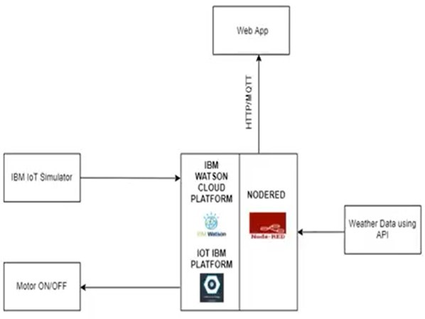
BLOCK DIAGRAM

Slide 4
Future Scope of IoT based Smart Agriculture System
Future work would be focused more on increasing sensors on this system to fetch more data especially with regard to Pest Control and by also integrating GPS module in this system to enhance this Agriculture IoT Technology to full-fledged Agriculture Precision ready product.

